Slide 1
The Zack Files: The Boy Who Cried Bigfoot
Tutor: Ivo Ganchev
Associate Lecturer, University of London
Time: 30 mins
Book Club: Chapter 4

Slide 2
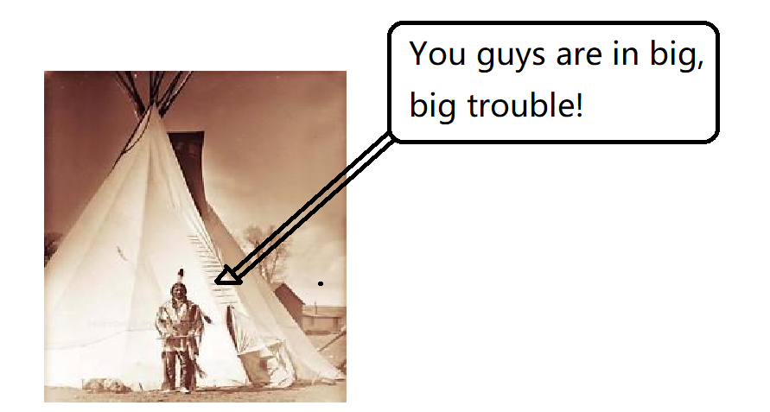
Chapter 3: Recap

Slide 3
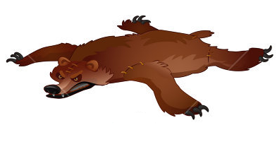
What clothes did they wear?

Slide 4
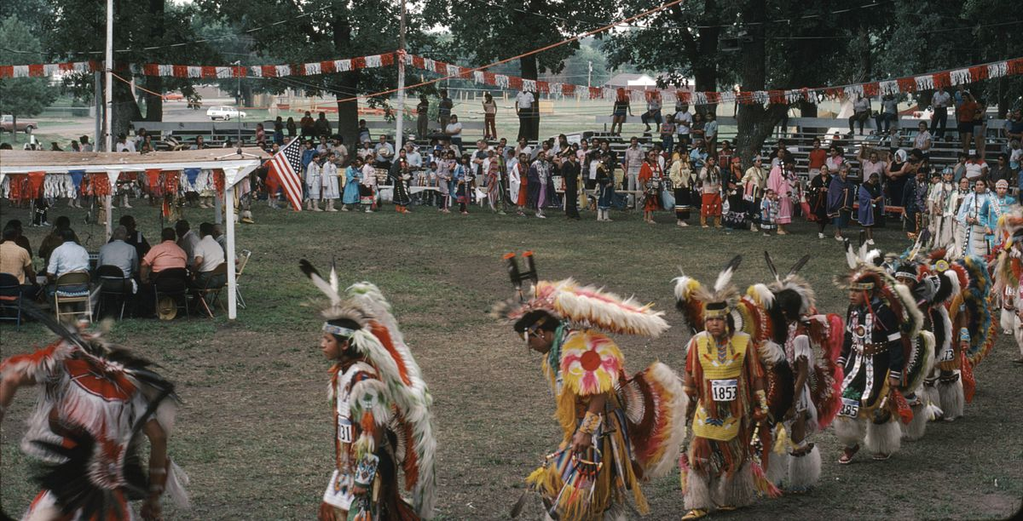
Powwow
Formal Meeting

Slide 5
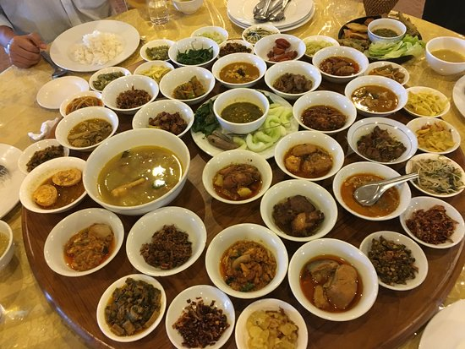
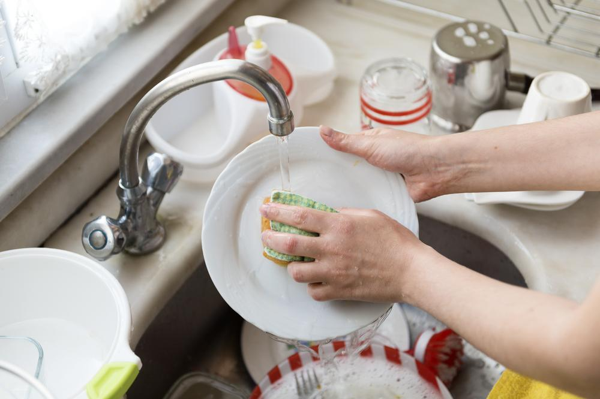
Zack and Spencer’s Punishment

Slide 6
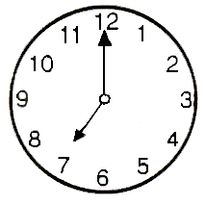
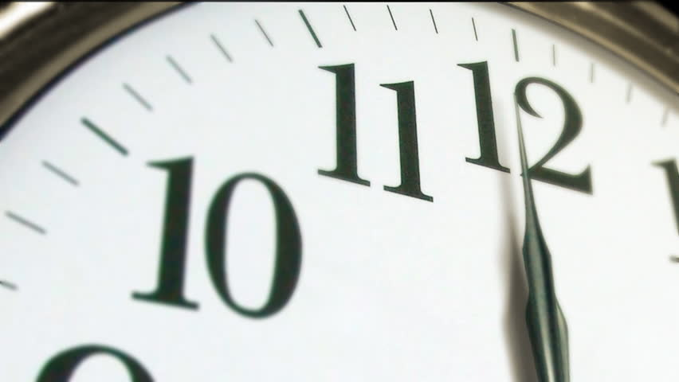
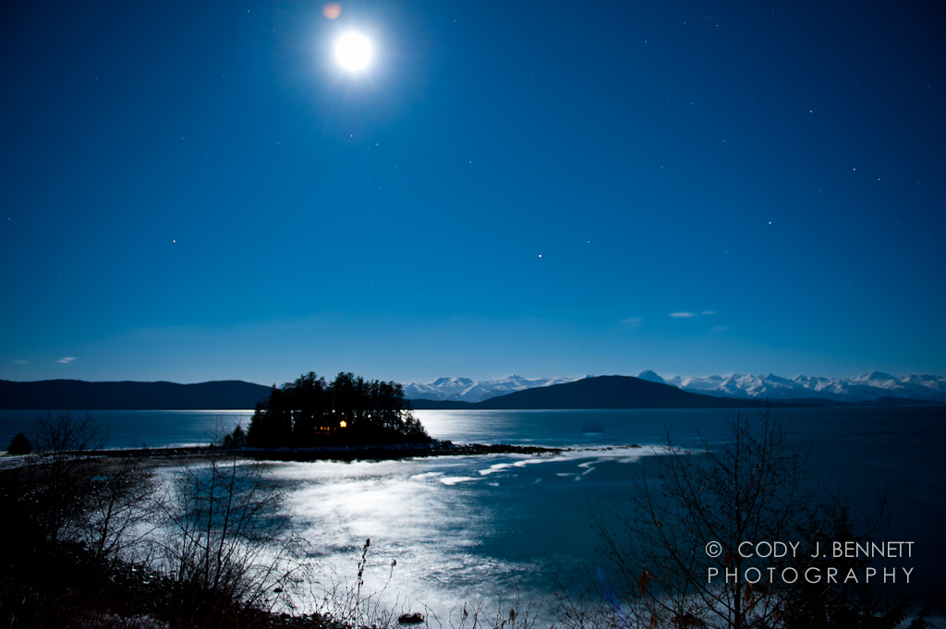
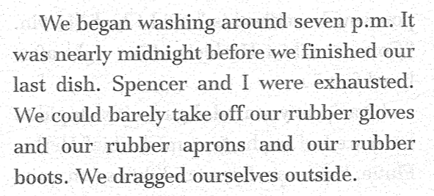
Zack and Spencer’s Punishment

Slide 7
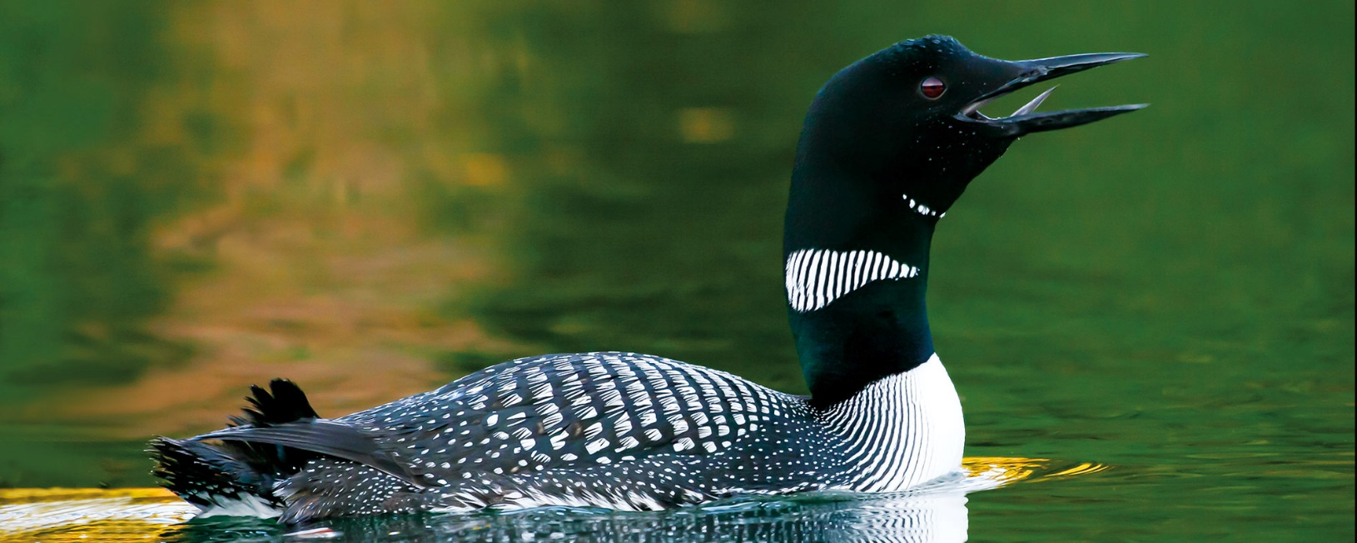
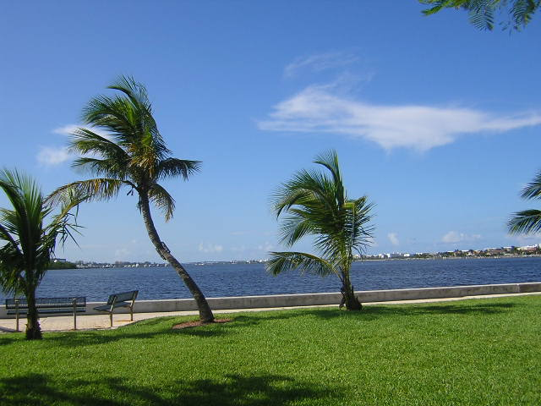
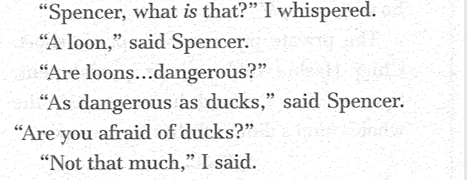
Sounds and Actions
loon
swaying

Slide 8
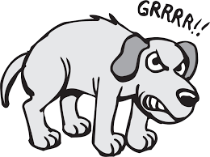
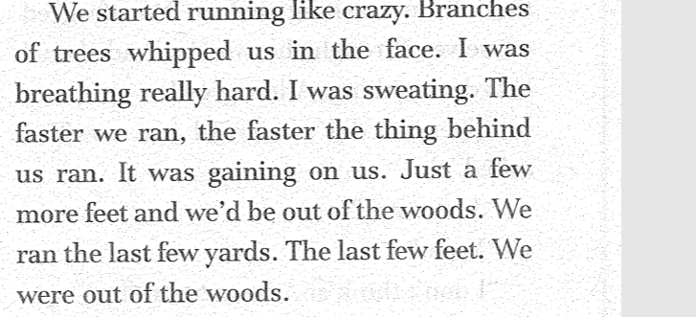
Zack Senses Something Strange
growl

Slide 9
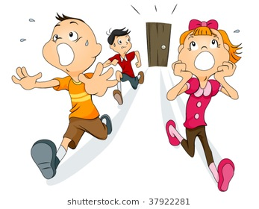
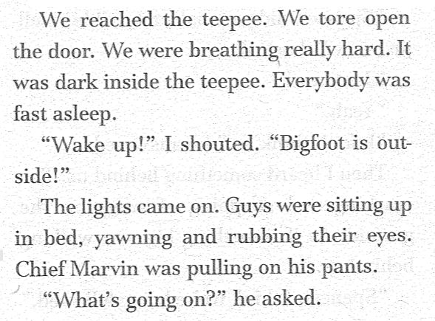
Run, Run, Run!

Slide 10
Agreement

Slide 11
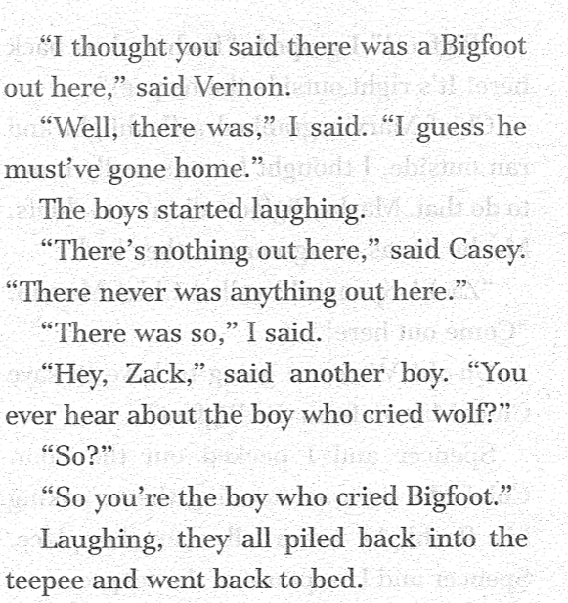
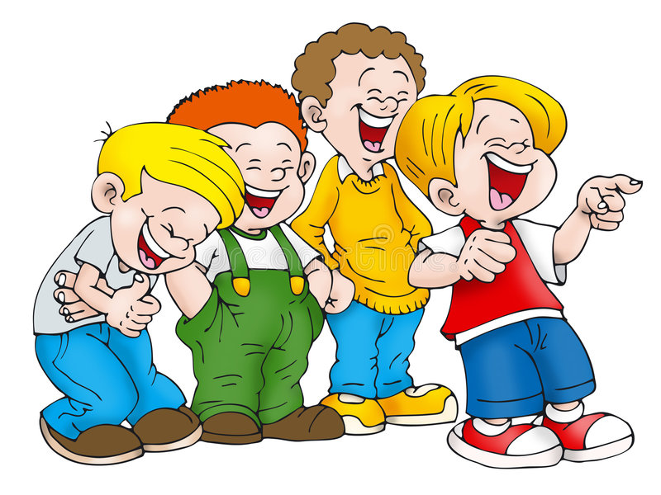
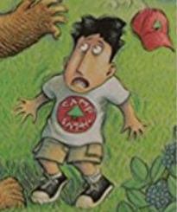
Feeling Embarrassed

Slide 12
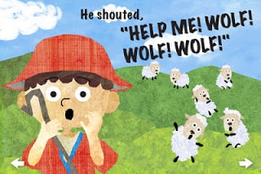
The Boy Who Cried Bigfoot

Slide 13
The Boy Who Cried Bigfoot
Read Chapter 5.
See you next week!

