Slide 1
The Zack Files: The Boy Who Cried Bigfoot
Tutor: Ivo Ganchev
Associate Lecturer, University of London
Time: 30 mins
Book Club: Chapter 6

Slide 2
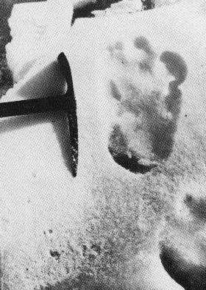
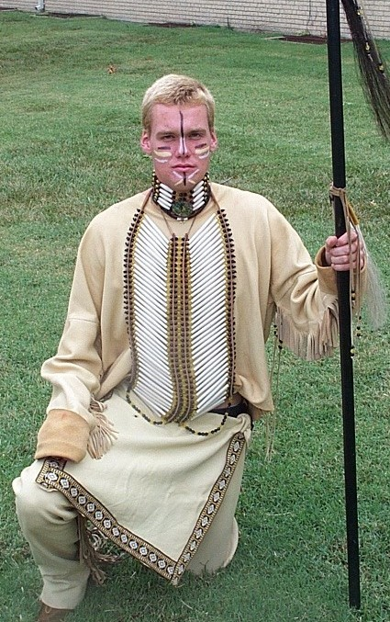
Chapter 6: Recap

Slide 3
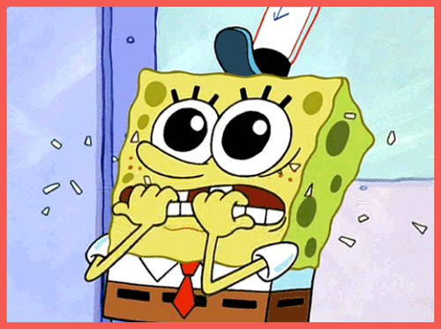
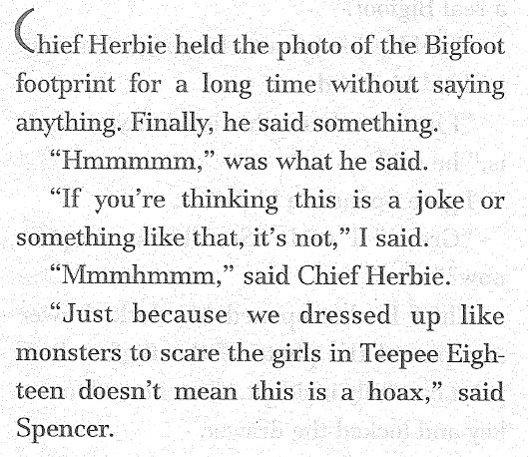
Chief Herbie’s Response

Slide 4
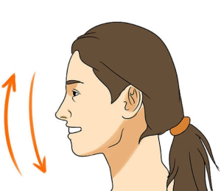
Success?
Nod

Slide 5
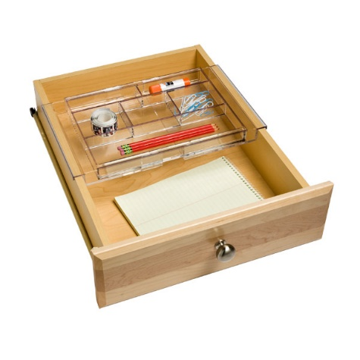
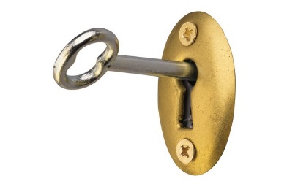
Success?
Chief Herbie opened his desk drawer and placed the photo of the Bigfoot footprint carefully inside it. Then he took out a key and locked the drawer.
“Our plan,” said Chief Herbie, “is to tell nobody about this at all. Not a soul.”

Slide 6
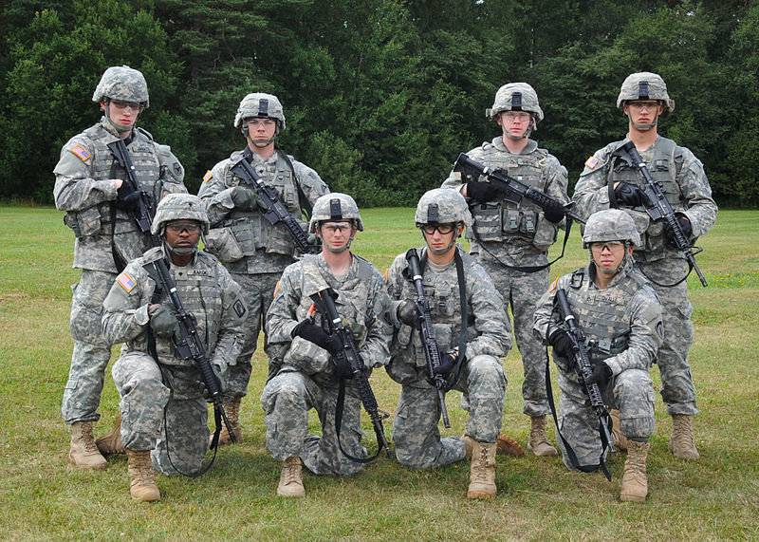
National Guard

Slide 7
Chief Herbie
Chief Herbie slowly shook his head.
“Then what?” said Spencer.
“Then nothing,” said Chief Herbie.
“Excuse me?” said Spencer. I don’t understand.
“What didn’t you understand?” said Chief Herbie.
“It sounded just like you said nothing was going to be done about the Bigfoot.”
“That’s correct,” said Chief Herbie.
“Why not?” I asked.
“Because,” said Chief Herbie, “all I need now is for there to be some big story about a Bigfoot here in the camp. Every parent of every camper in this place is going to yank their kids out of Camp Weno-wanna-getta-wedgee.”
“And you’ll lose all the mney they paid you for the summer,” I said.

Slide 8
What kind of person is Chief Herbie?

Slide 9
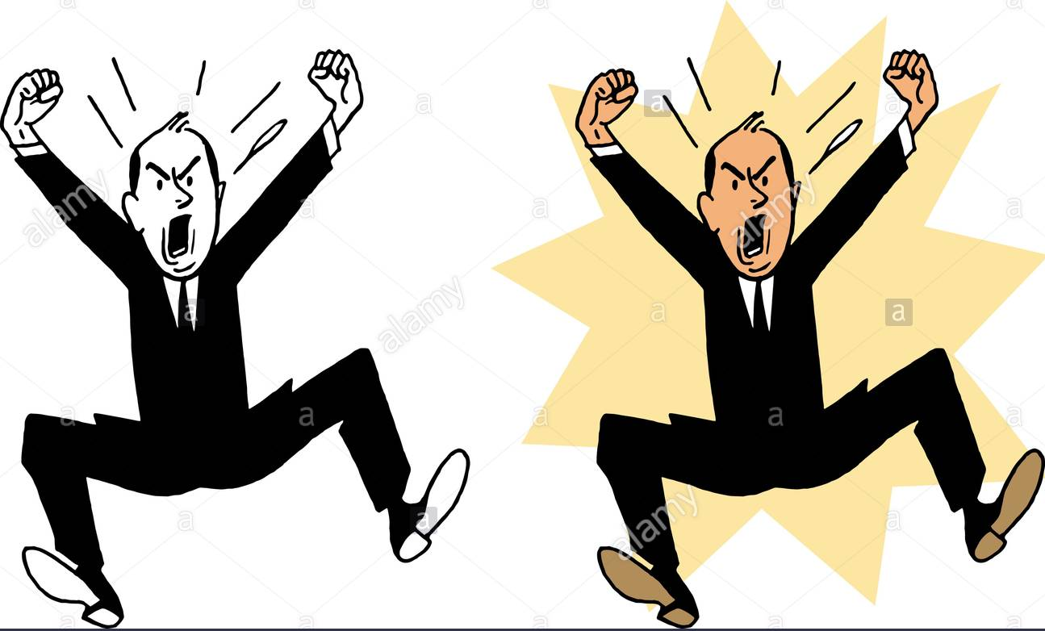
Hopping mad!

Slide 10
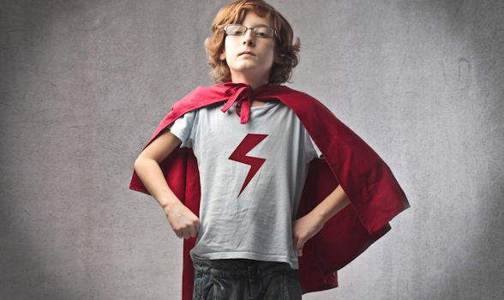
The Boys Are Brave
“If he’s not going to do anything, then we have to.”

Slide 11
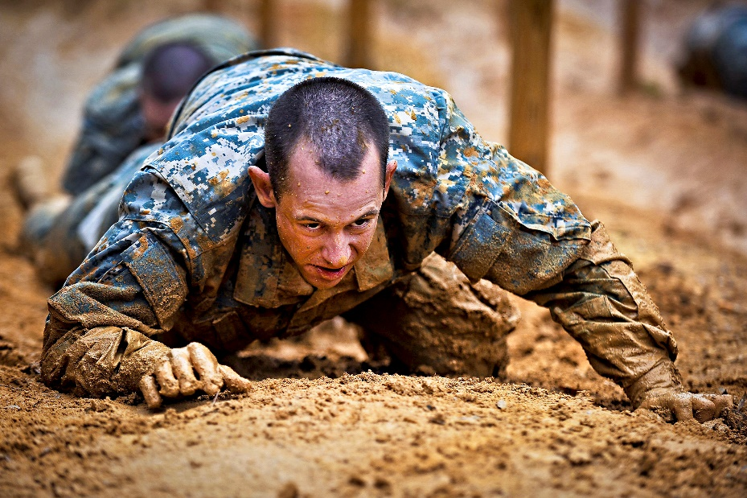
The Boys in Action
We hurried back to our teepee and got the camera. Then we tried to find the best footprint to photograph. We crawled around on our hands and knees.

Slide 12
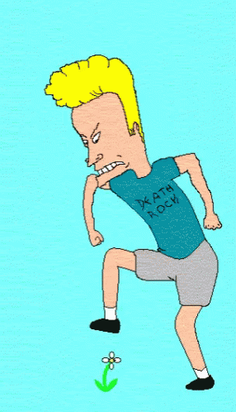
The Footprints Are Gone!
“That’s weird,” said Spencer.
“What?” I asked.
“Not only can’t I find a good footprint, I can’t find any footprints at all.”
“Me either. What’s going on here?” I said. And then it hit me. “Oh no.”
“What?”
“Chief Herbie beat us over here and got rid of the footprints. Now we have zero evidence!”

Slide 13
Prepare for Next Class
Read Chapter 7.
Will the boys give up or keep looking for evidence? How will they solve this problem and what other ways to they have of proving that Bigfoot exists?
See you next week!

