Slide 1
The Zack Files: The Boy Who Cried Bigfoot
Tutor: Ivo Ganchev
Associate Lecturer, University of London
Time: 30 mins
Book Club: Chapter 7

Slide 2
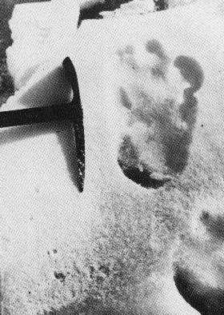
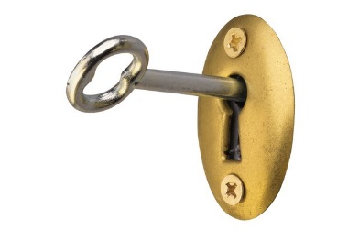
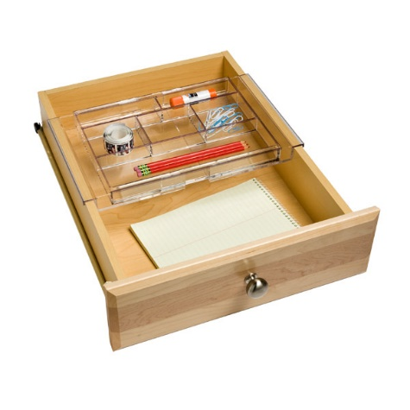
Chapter 6: Recap

Slide 3
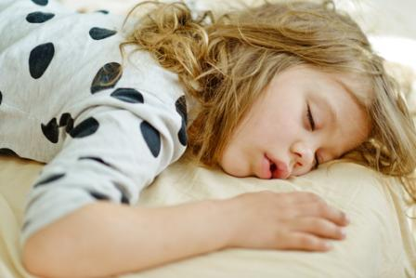
The Boys Feel Disappointed
We tried to tell Chief Marvin and the guys in the teepee about what happened. About the photo of the footprint and the meeting with Chief Herbie. But when we told them the footprints near the teepee had disappeared, they just laughed at us.
By the time bedtime rolled around, neither Spencer nor I were in too hot of a mood.

Slide 4
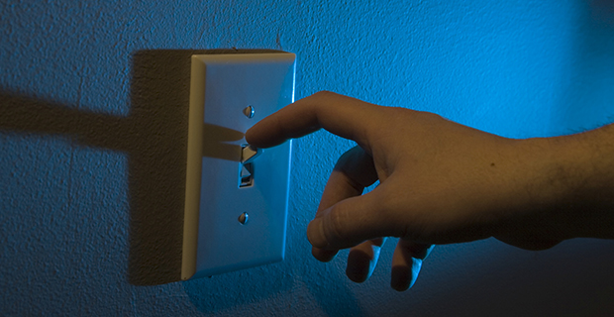
Lights-out

Slide 5
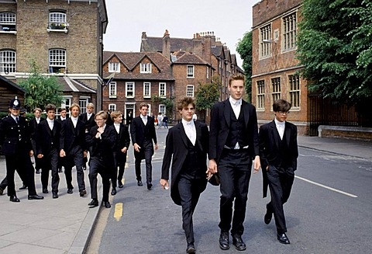
Boarding School

Slide 6
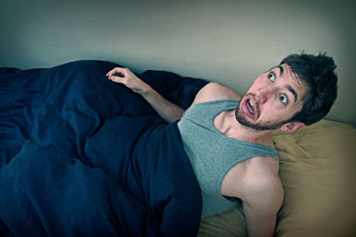
Jolted Awake
Thinking, don’t even remember falling asleep. But I do remember being jolted awake by an awful sound.

Slide 7
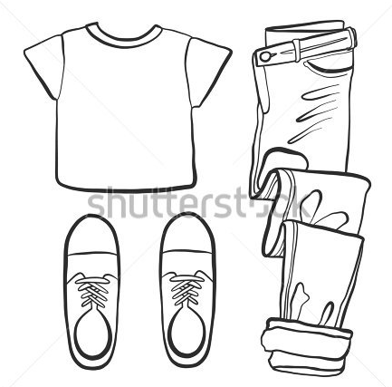
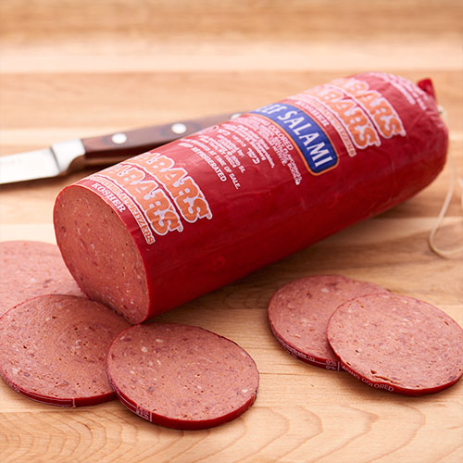
Get Ready for an Adventure!

Slide 8
Where is the sound coming from?
“It’s coming from the woods,” I said. “It sounded like it’s really hurting.” “That could be a trick to get us to come into the woods,” said Spencer. “So it can attack us.”
We heard the sound again. “I can’t stand listening to that,” I said. “I’m going to go see what it is. I’m coming with you,” said Spencer.

Slide 9
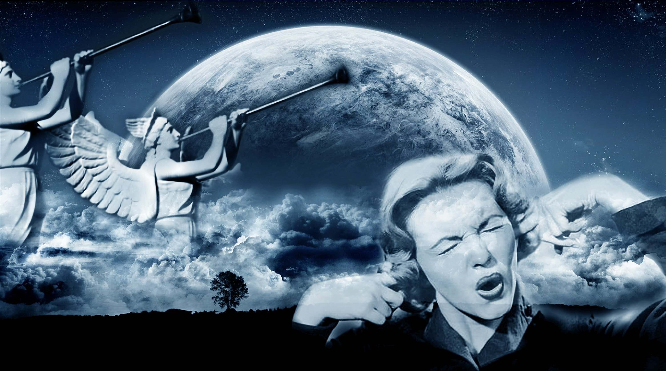
True Friends and Strange Sounds

Slide 10
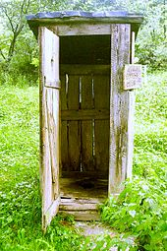
Let’s read
Outhouse
The stink from the pit was worse than anything I had ever smelled before. Worse than Vernon. We crept up to the edge of the pit. It had been covered over with branches. Something must have walked on the branches and fallen through them. The pit was about twelve felt deep. At the bottom lay something huge and furry. Its feet were the biggest one I’d ever seen.

Slide 11
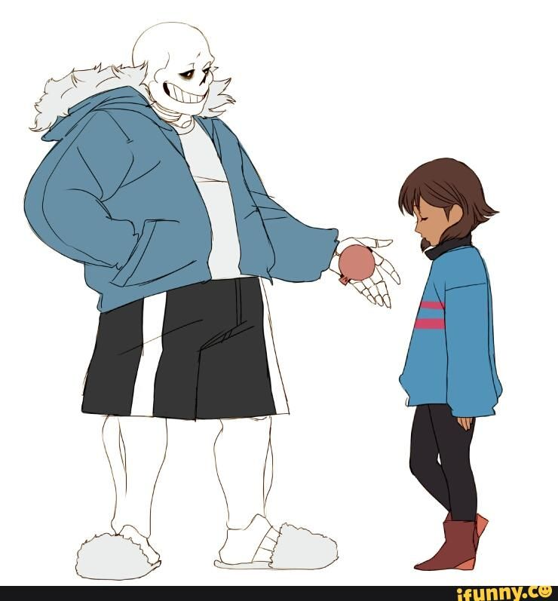
Reasoning
Good Manners: Handshake

Slide 12
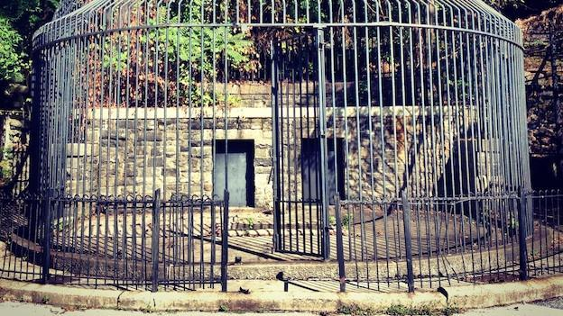
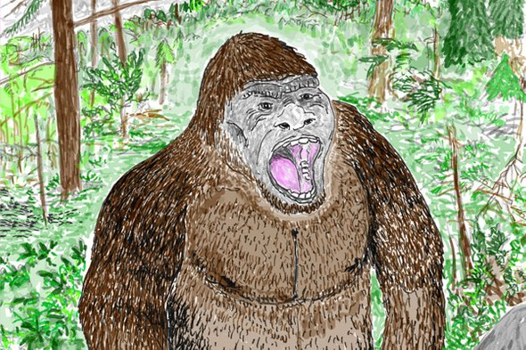
Keeping Freddy Safe
Read Chapter 8.
See you next week!

